Slide 1
Image Retrieval
Content-Based and Text-Based

Slide 2
Group Members
Mohammad Anas (20L-1289)
Fatima Azfar (20L-1027)

Slide 3
Outline
Introduction
Motivation
CBIR
Feature Extraction
Image Representation
Feature Selection
Similarity Measure
TBIR
Image Annotation
Text Processing
Indexing
Querying
Ranking and Presentation
Conclusion

Slide 4
Introduction
Content and Text-based retrieval systems enable searching and finding images using text-based queries.
These systems use textual annotations, descriptions, or metadata associated with images.
Textual information is indexed and matched to facilitate search and retrieval.
Users can search for images using keywords, phrases, or natural language queries.
The retrieved images are ranked based on relevance to the query.
The results are presented to users for efficient navigation through large image collections.

Slide 5
Content-Based Image Retrieval (CBIR)
Content-based image retrieval (CBIR) is a technique for retrieving images from a large collection based on their visual content, such as color, texture, and shape. The aim of CBIR is to find images that are similar or related to a query image. CBIR has a wide range of applications, including image search engines, medical image analysis, and surveillance systems.
CBIR systems typically consist of four main components:
Image Representation
Feature Extraction
Feature Selection
Similarity Measurement

Slide 6
Feature Extraction and Image Representation
In CBIR, images are represented as a set of features that capture their visual content.
The most commonly used image representations are:
Color Histograms
Texture Descriptors
Shape Descriptors

Slide 7
Color Histograms
Color histograms represent the distribution of colors in an image. A histogram is a graphical representation of the frequency of occurrence of different color values in an image. The color values are typically binned into a fixed number of discrete intervals, and the frequency of occurrence of each bin is computed. The resulting histogram is a vector of values that represents the color content of the image. Color histograms are simple and computationally efficient, but they may not capture all the relevant visual information of an image.

Slide 8
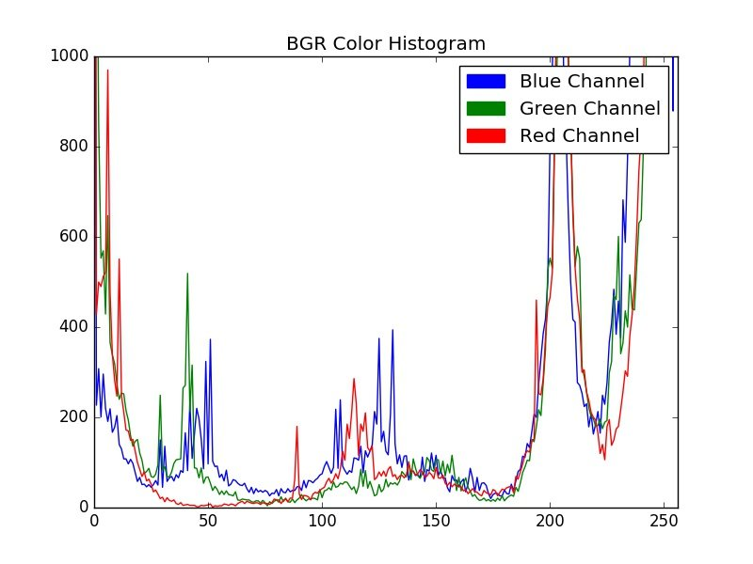
Y-axis: Number of Pixels
X-axis: Bins of Colors

Slide 9
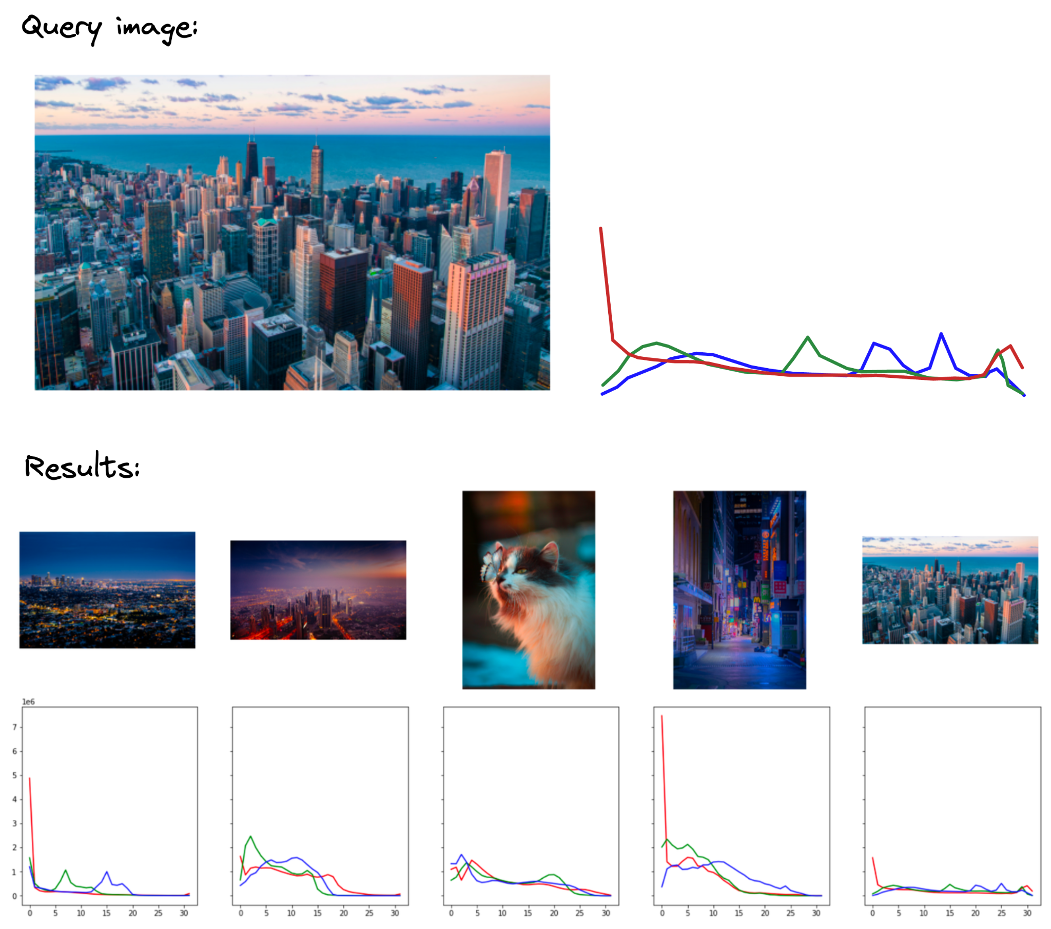

Slide 10
Texture Descriptors
Texture descriptors represent the visual patterns in an image, such as roughness, smoothness, and regularity. Texture descriptors are typically computed using statistical measures such as Gabor filters or local binary patterns.
Gabor filters are a family of bandpass filters that are widely used for texture analysis. Gabor filters are designed to capture the local orientation and frequency of texture patterns in an image.
Local binary patterns (LBP) are another commonly used texture descriptor that encodes texture information by comparing the intensity values of neighboring pixels.
Texture descriptors are more complex and computationally expensive than color histograms, but they can capture more detailed visual information.

Slide 11
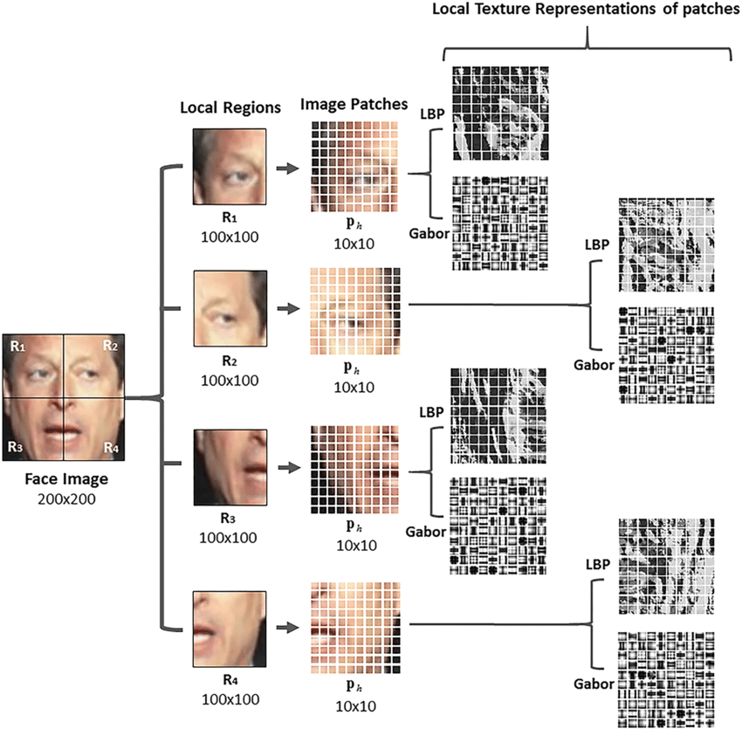

Slide 12
Shape Descriptors
Shape descriptors represent the geometric shape of objects in an image. Shape descriptors are typically computed using geometric features such as Fourier descriptors or shape context.
Fourier descriptors represent the shape of an object as a series of sine and cosine waves, the contour of the object is treated as a periodic function and decomposed into its frequency components.
Shape context represents the shape of an object as a distribution of local features, the basic idea behind shape context is to describe the spatial distribution of points around an object's contour.
Shape descriptors are the most complex and computationally expensive type of image representation, but they can capture important information about the shape and structure of objects in an image.

Slide 13
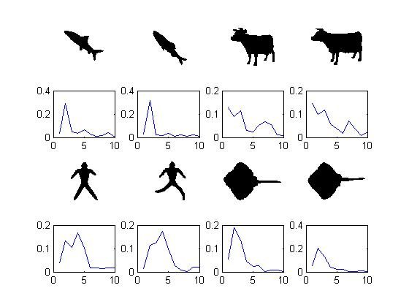
Fourier Descriptor
Y-axis: Magnitude of Normalized Fourier Coefficient
X-axis: Frequency

Slide 14
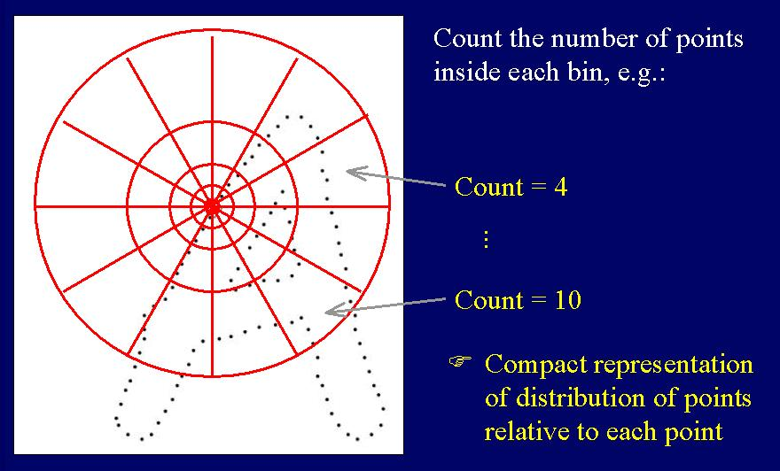
Shape
Context Descriptor

Slide 15
Honorable mention
SIFT (Scale-Invariant Feature Transform)
SIFT is a popular algorithm used in computer vision for detecting and describing local features in images. It was introduced by David Lowe in 1999 and has since become one of the most widely used feature extraction techniques.
The SIFT algorithm consists of four main steps:
Scale-space Extrema Detection
Keypoint Localization
Orientation Assignment
Feature Descriptor Generation

Slide 16
Bag of (Visual) Words
Bag of words (BoW) is a popular image representation technique that is commonly used in content-based image retrieval (CBIR) systems. BoW represents an image as a histogram of visual words that are extracted from the image using a visual vocabulary.
Here is a general overview of the process of storing an image in a BoW vector for CBIR:
Visual vocabulary creation
Feature Extraction
Quantization
Histogram Generation

Slide 17
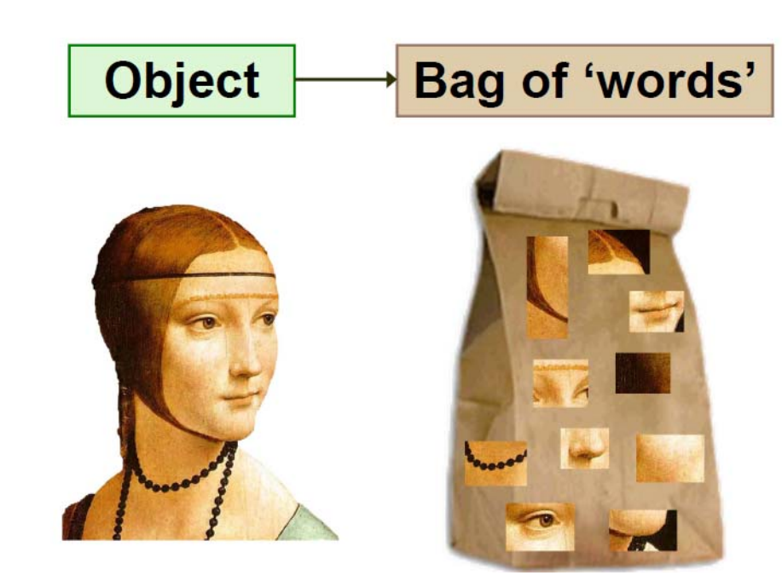
Represent an image with a histogram of the contents of the image i.e `Visual Words`

Slide 18
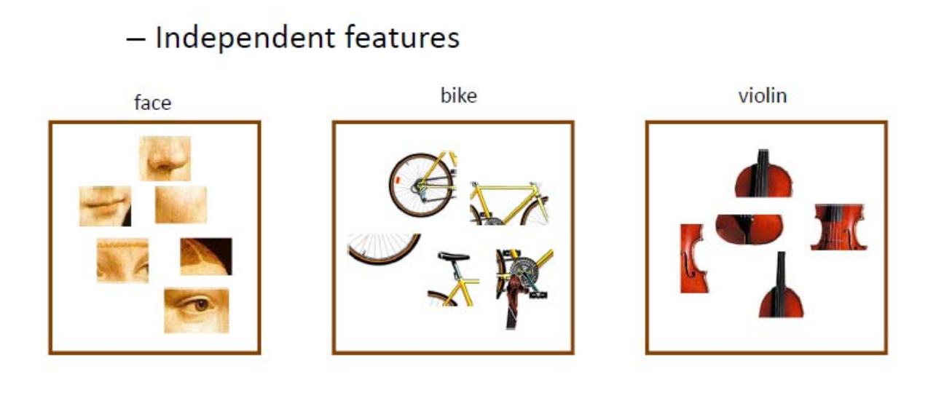

Slide 19
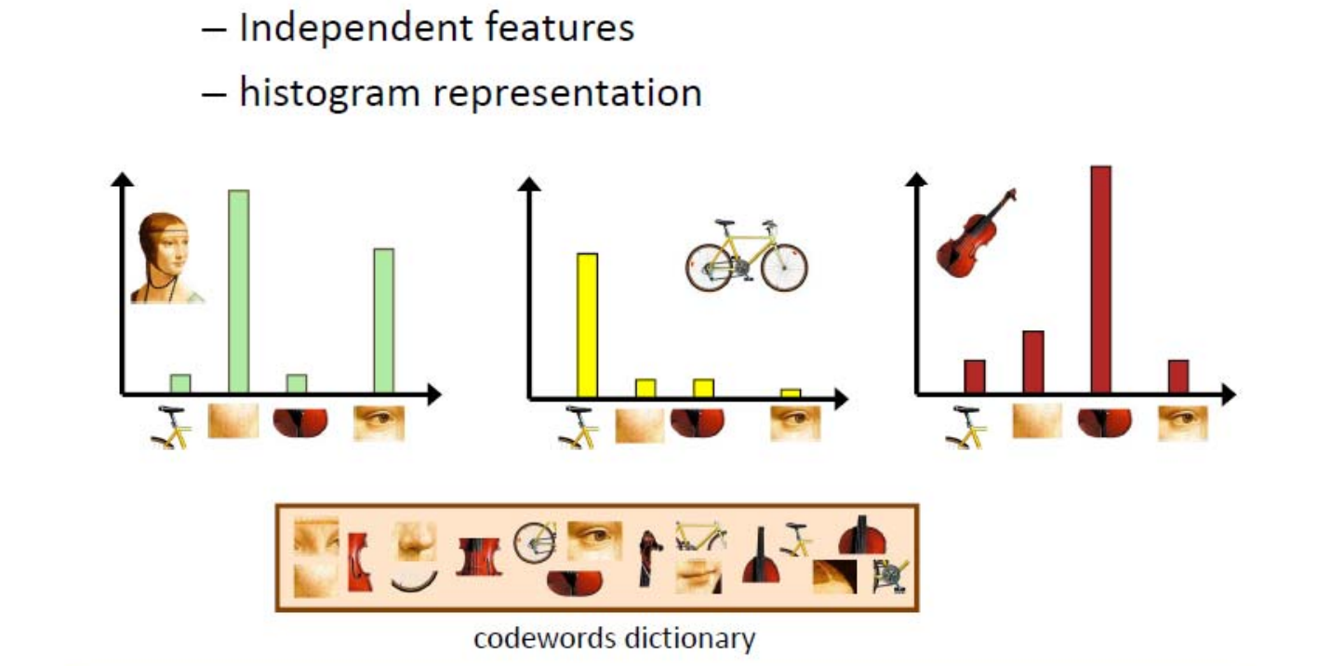

Slide 20
Feature Selection
Feature selection is the process of selecting a subset of relevant and discriminative features from a larger set of features. In Content-Based Image Retrieval (CBIR), feature selection is important for reducing the dimensionality of the feature vectors, improving the efficiency of image matching and retrieval, and reducing the effect of irrelevant or redundant features.
There are several feature selection techniques that can be used in CBIR, including:
Correlation-based feature selection (CFS)
Mutual information-based feature selection (MIFS)
Recursive feature elimination (RFE)
Principal component analysis (PCA)
Genetic algorithms (GA)

Slide 21
Similarity Measures
Similarity measures are used in Content-Based Image Retrieval (CBIR) to compare the feature vectors of a query image with the feature vectors of the images in a database, and to determine which images are most similar to the query image.
There are many different similarity measures that can be used in CBIR, including:
Euclidean distance
Cosine distance
Chi-Squared distance
Earth Mover's Distance (EMD)
Mahalanobis distance
Jaccard similarity

